Slide 1

Power Bi Capstone Project

Slide 2
PROJECT TITLE BANK LOAN PERFORMANCE ANALYSIS

Slide 3
1. Data CLEANING

Slide 4
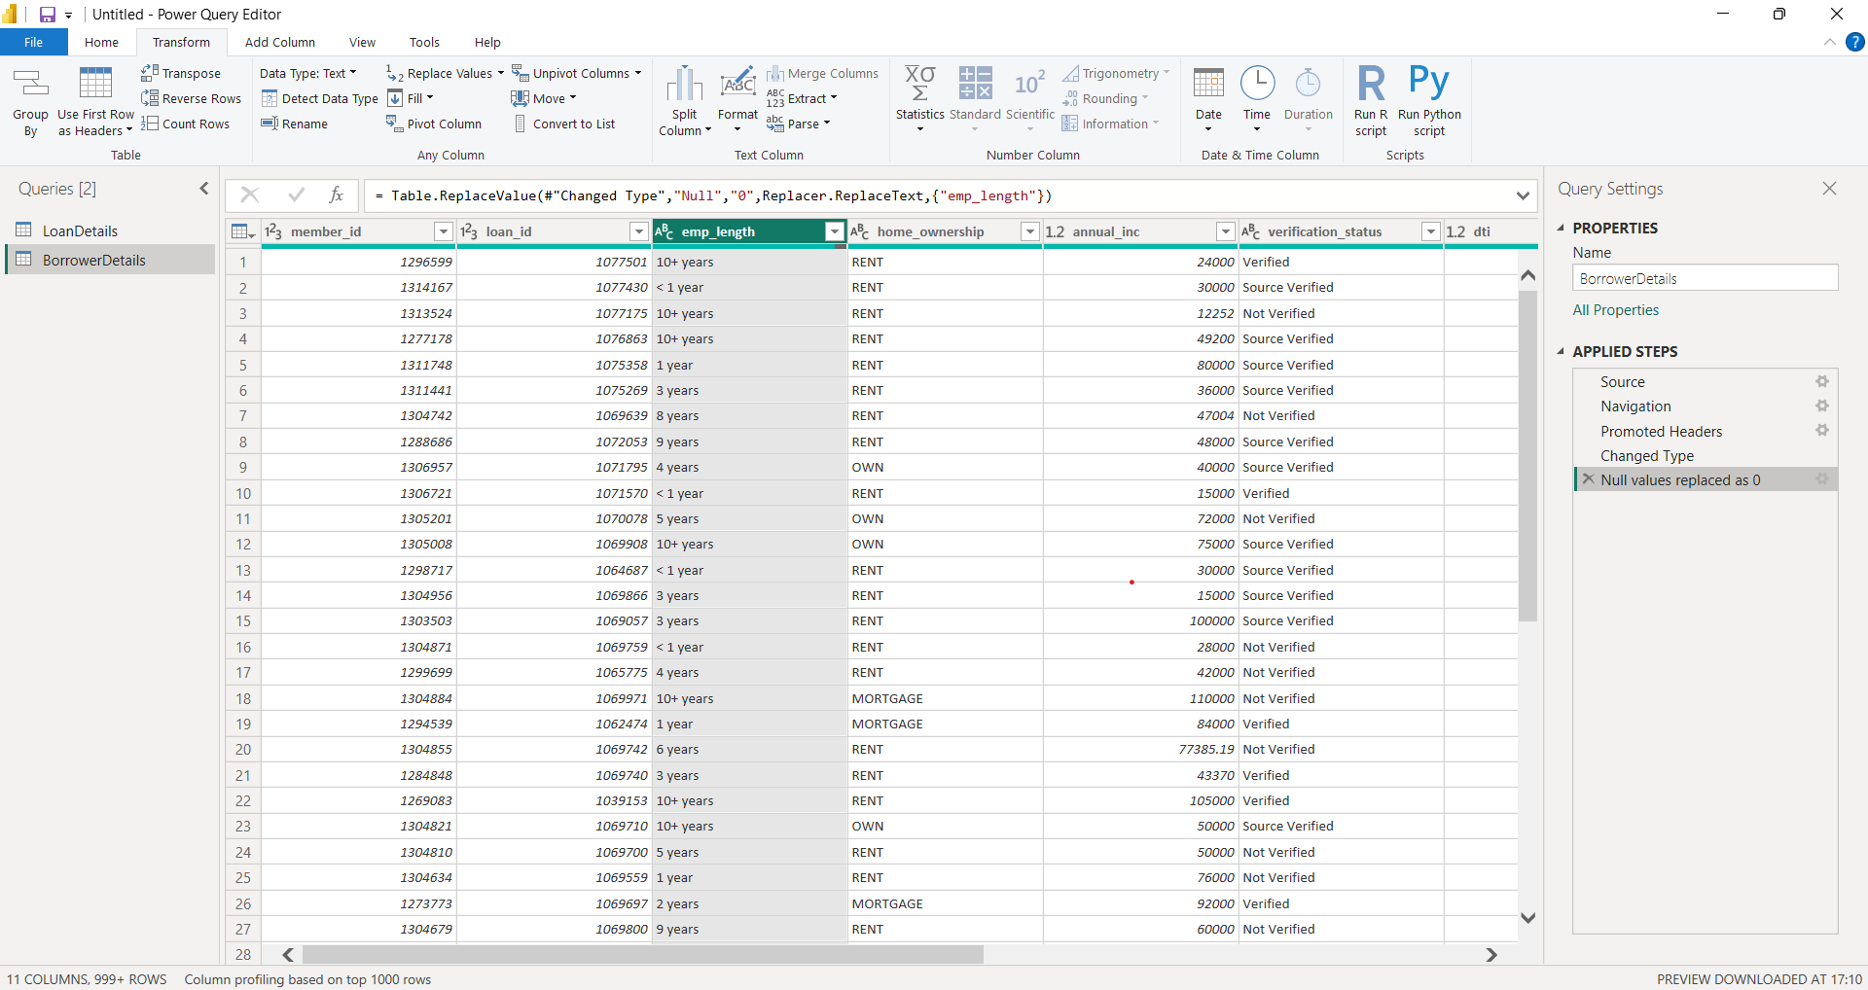
Handling Missing Values and Duplicates
Replace missing values (null) in the 'emp_length' column of the "BorrowerDetails"
table with '0 year'.

Slide 5
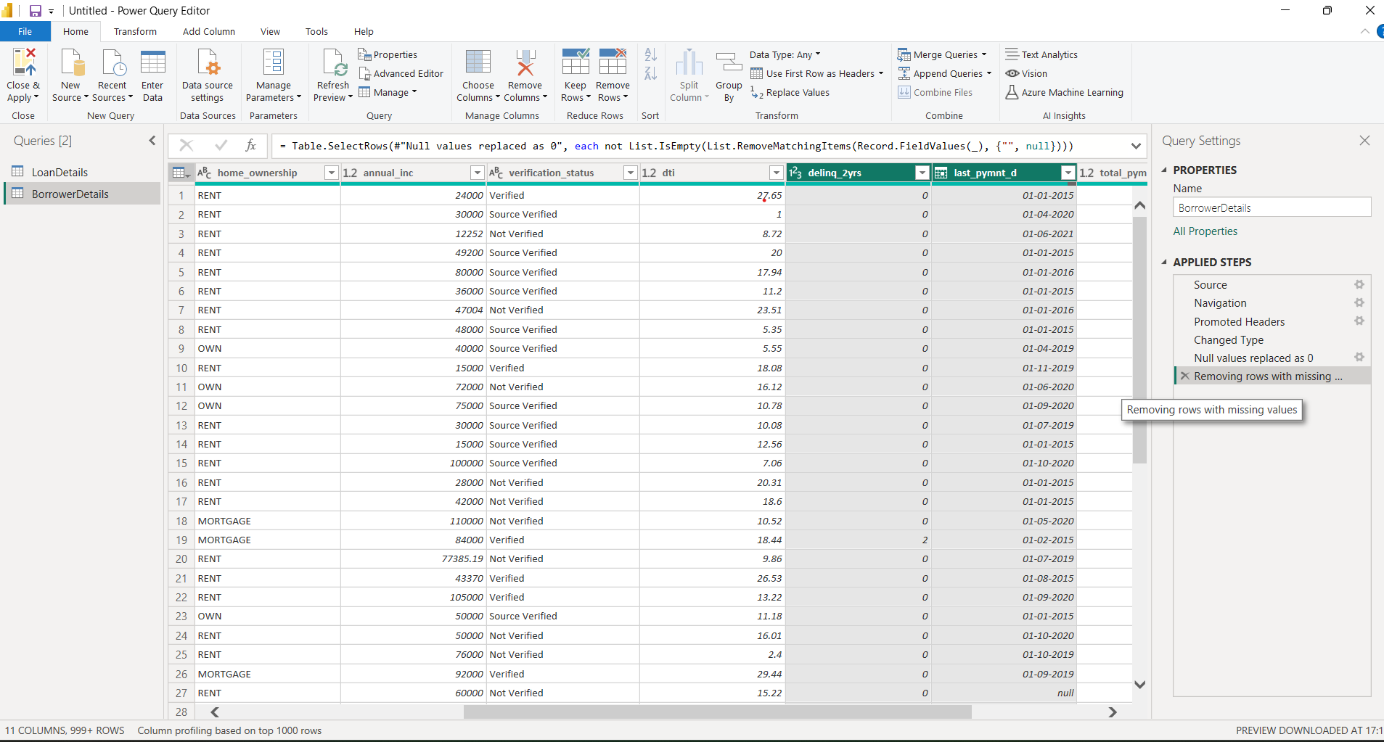
Remove rows with missing values in the 'last_pymnt_d' and 'delinq_2yrs' columns.

Slide 6
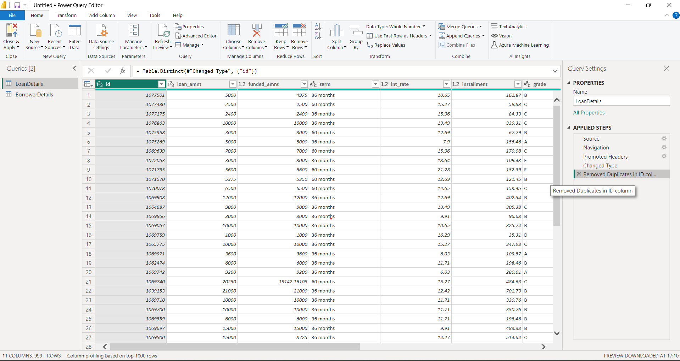
Remove duplicate rows in the 'id' column of the "LoanDetails" table.

Slide 7
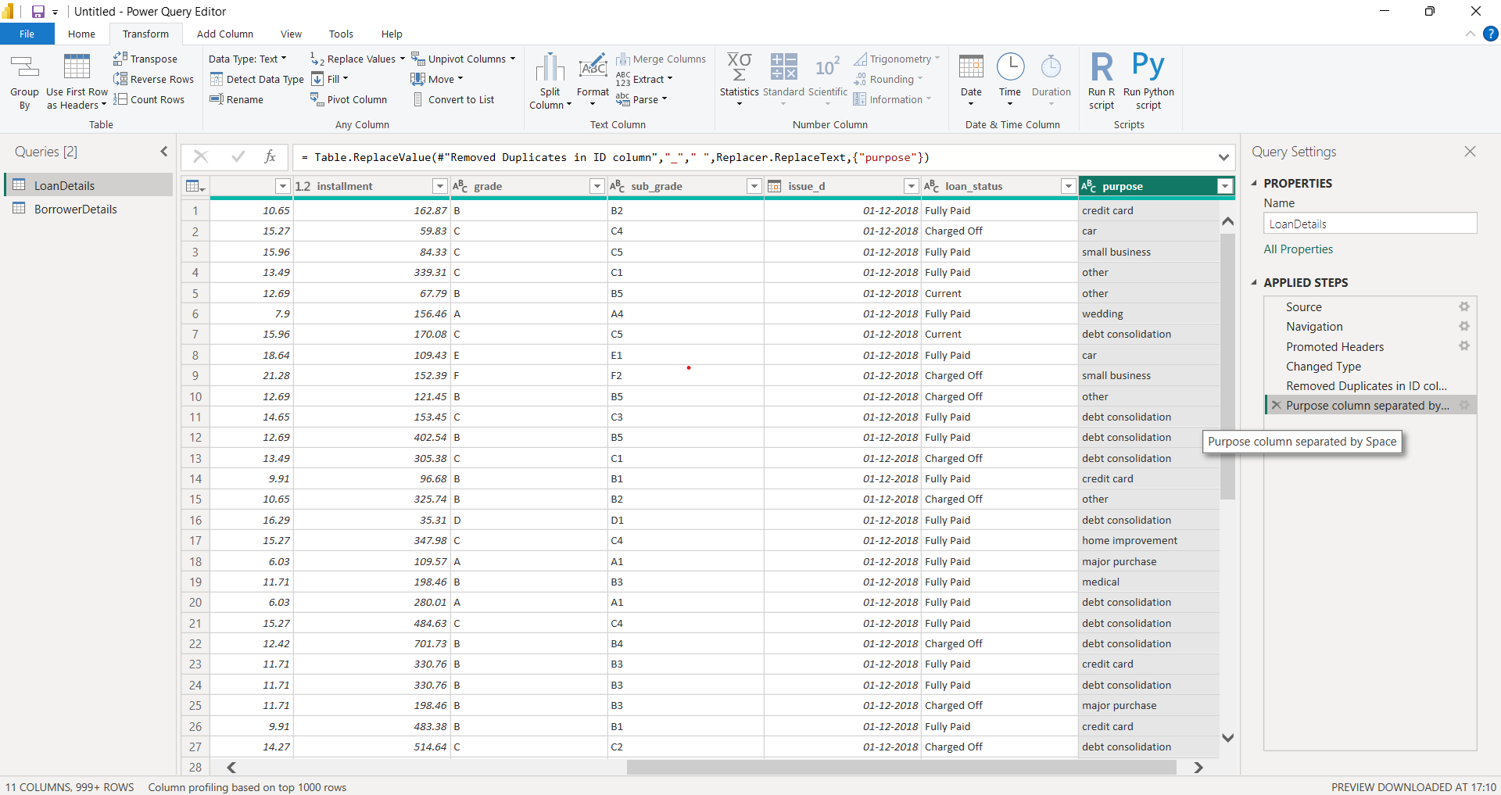
Dealing with Inconsistencies
Ensure words in the 'purpose' column are separated by spaces instead of underscores (e.g., "credit card" instead of "credit_card").

Slide 8
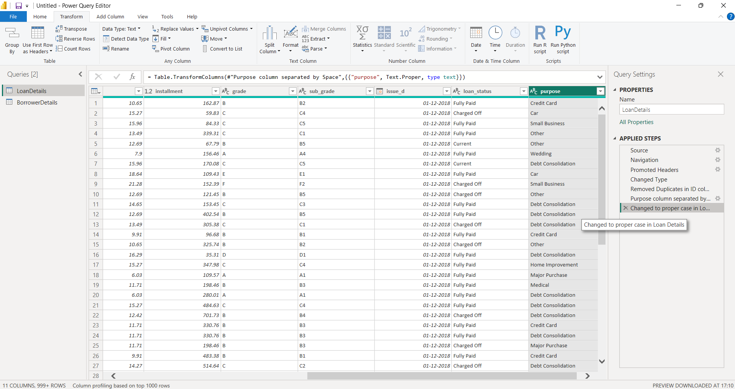
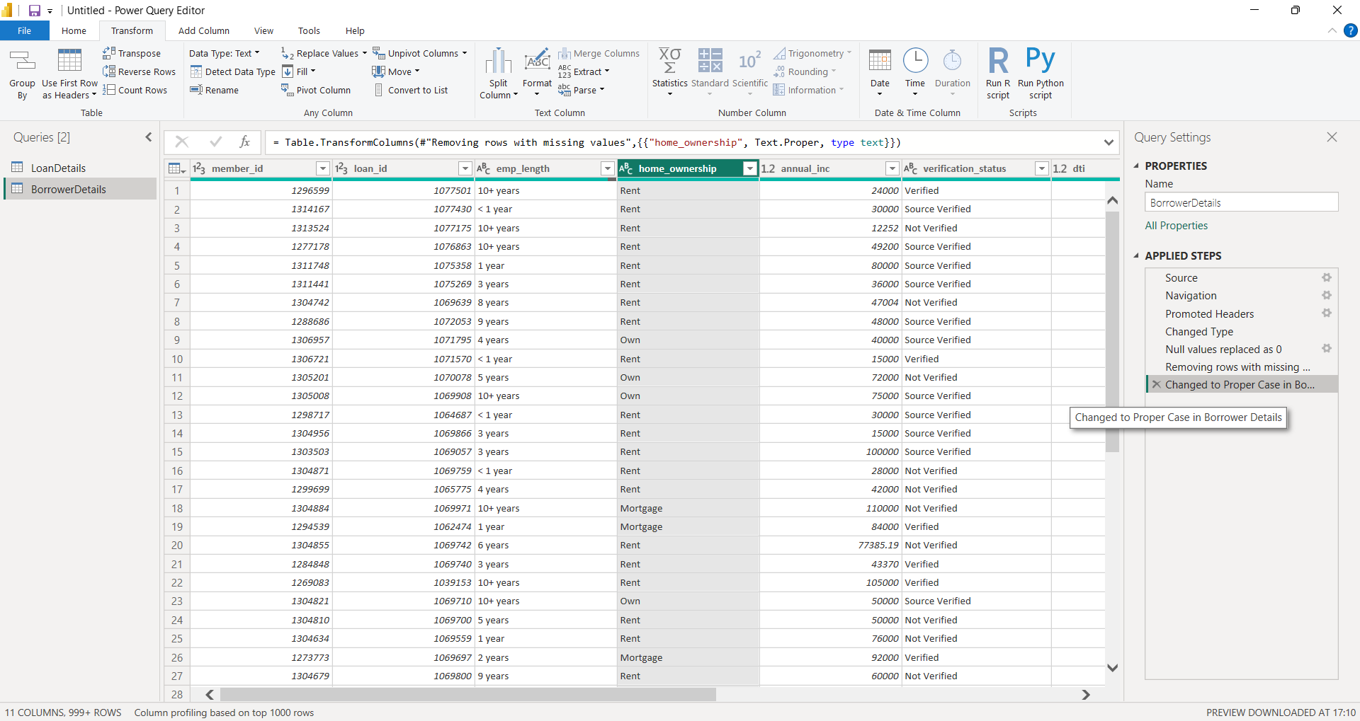
Format the 'purpose' and 'home_ownership' columns to proper case.

Slide 9
2. Data Transformation

Slide 10
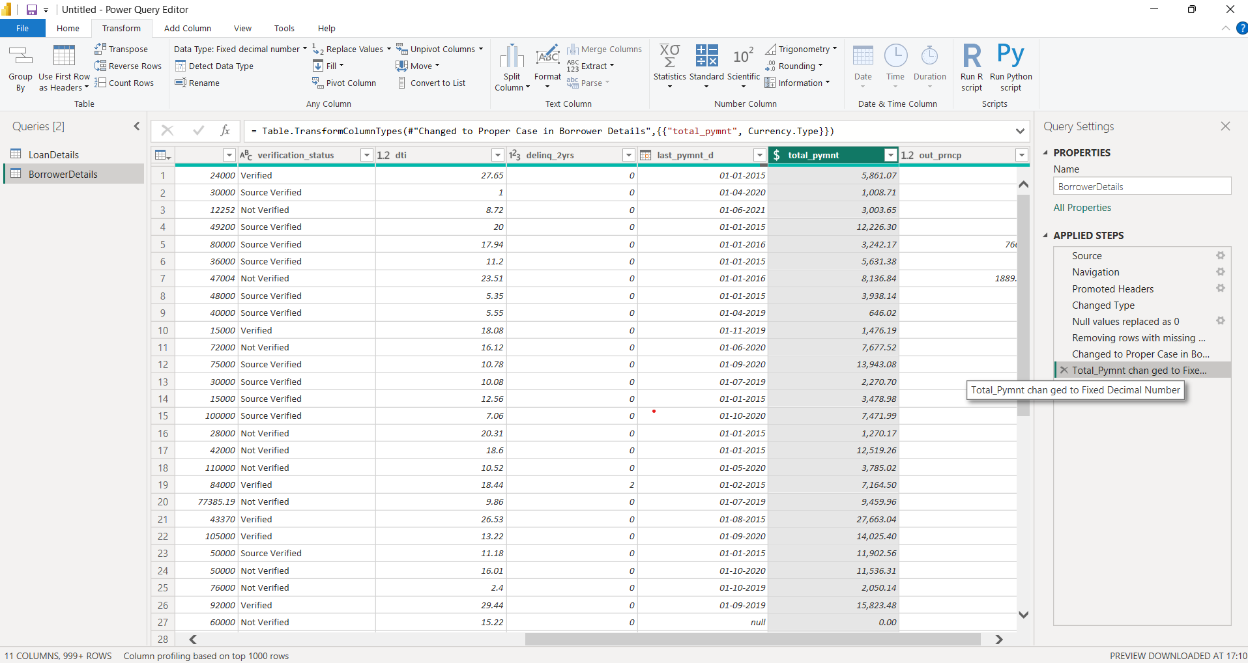
Column Transformation
Change the data type of the 'total_pymnt' column to 'Fixed decimal number'.

Slide 11
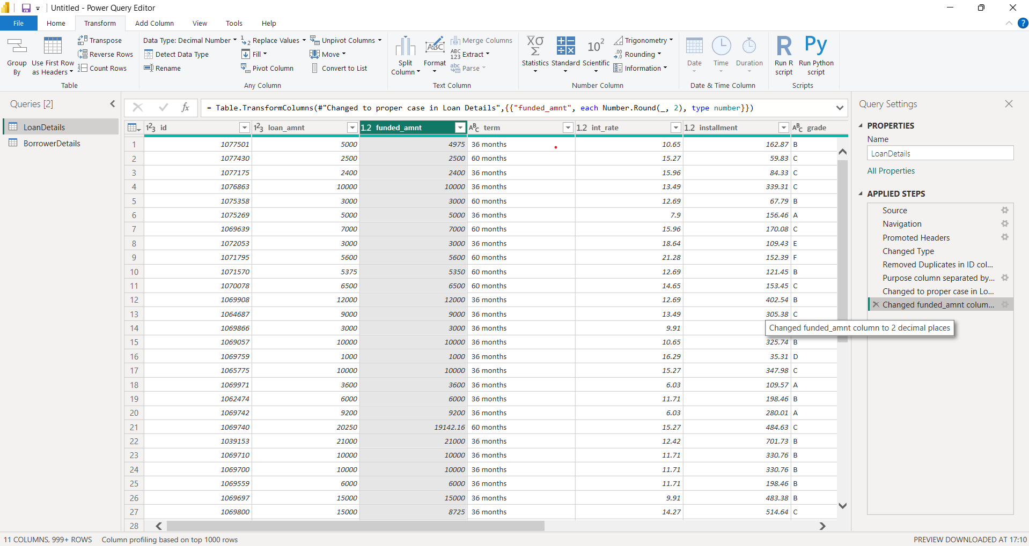
Round off the numbers in the 'funded_amnt' column to 2 decimal places.

Slide 12
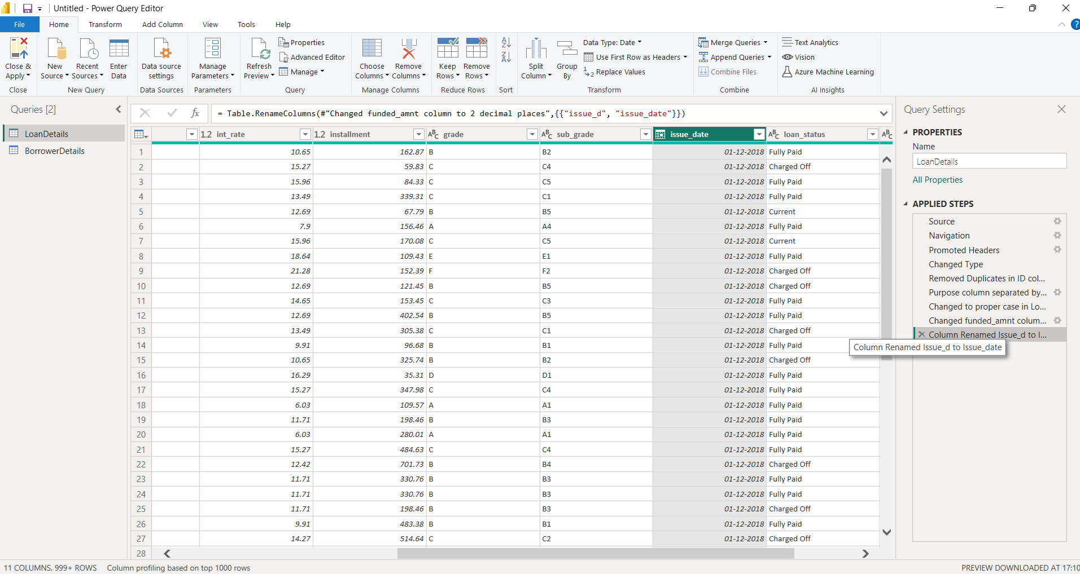
Column Renaming
Rename the column 'issue_d' to 'issue_date'.

Slide 13
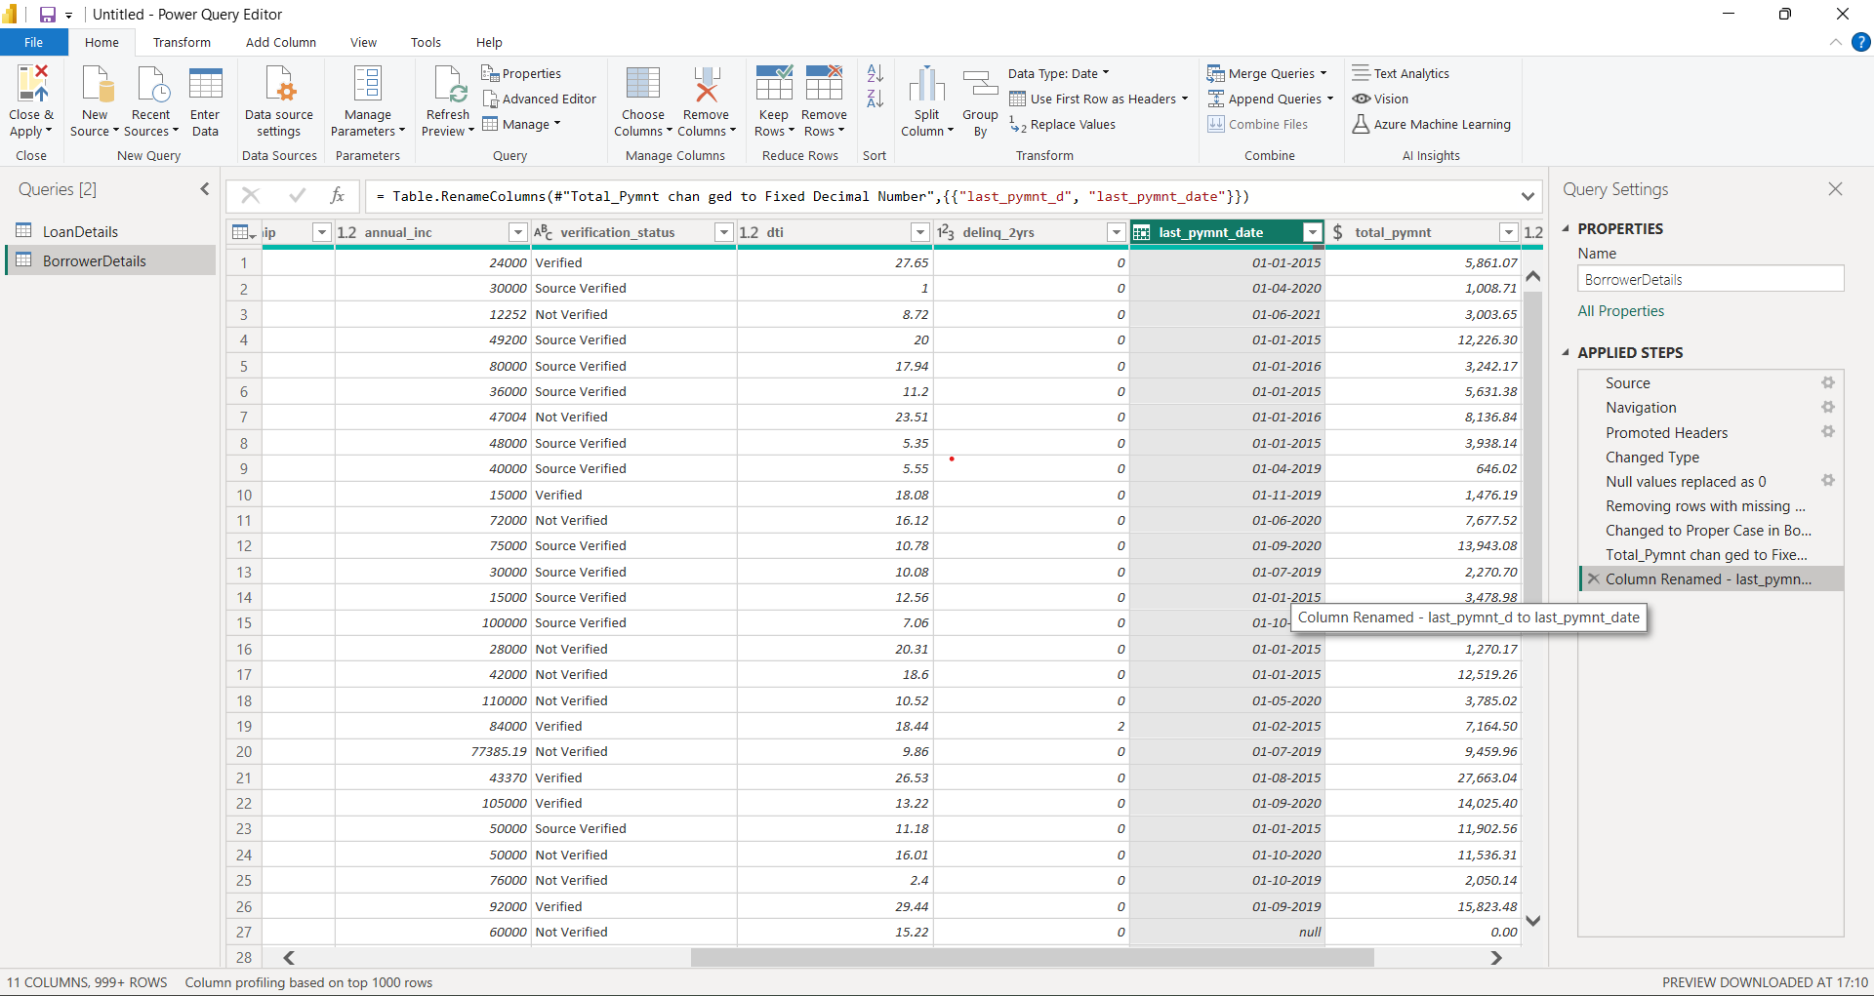
Rename the column 'last_pymnt_d' to 'last_pymnt_date'.

Slide 14
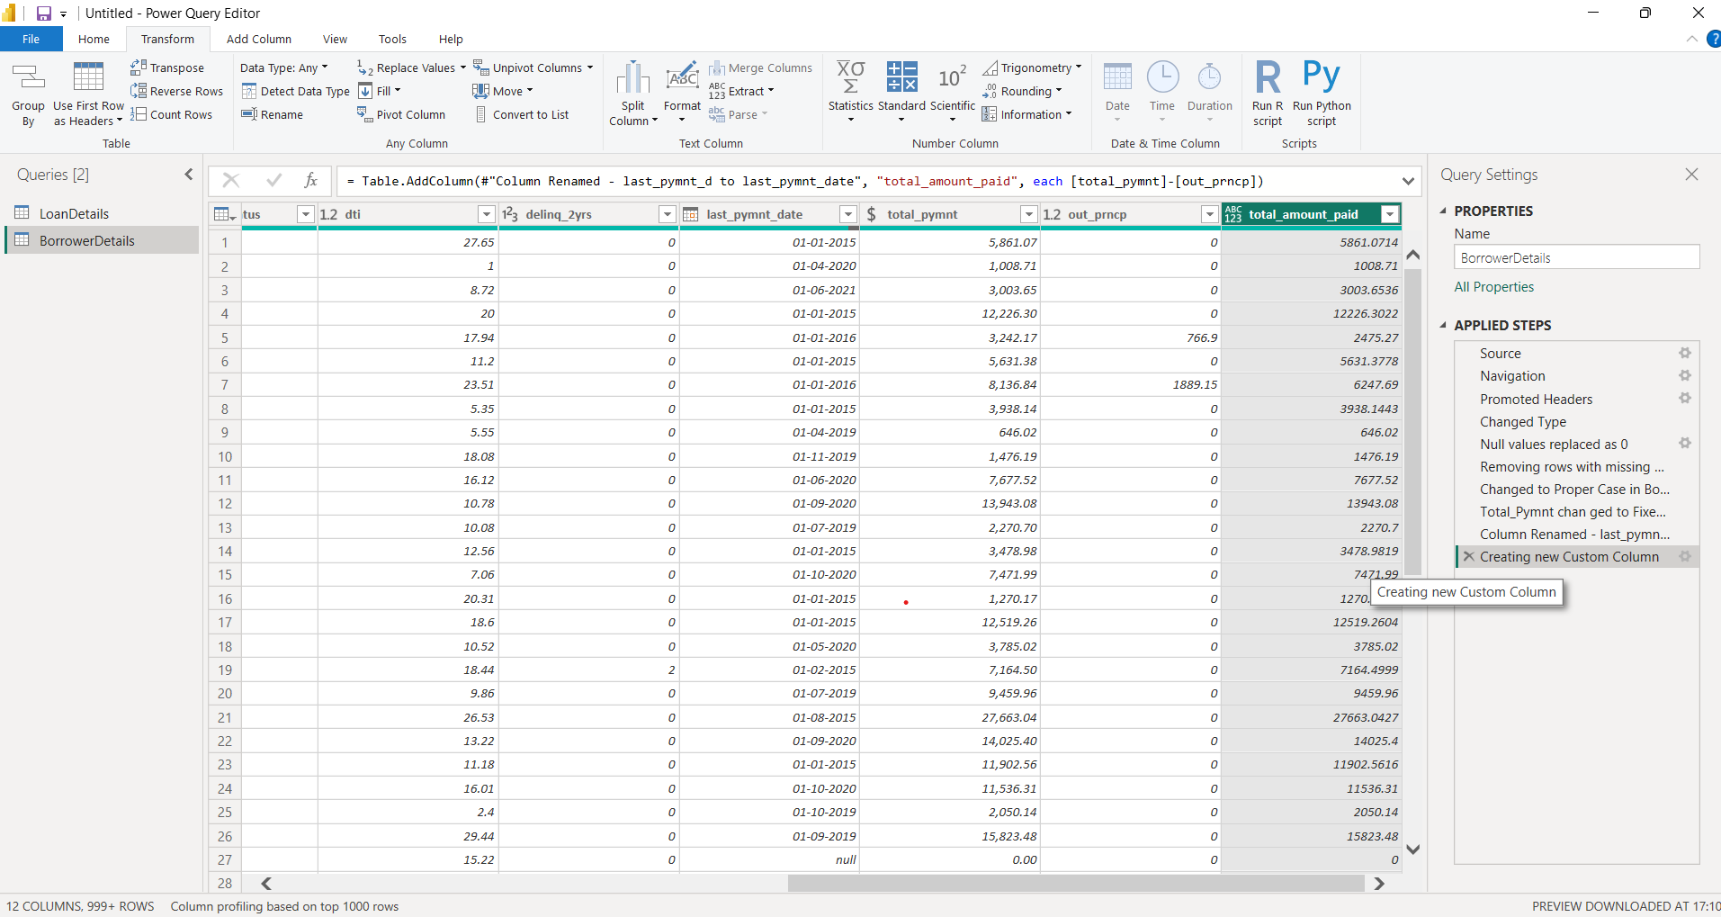
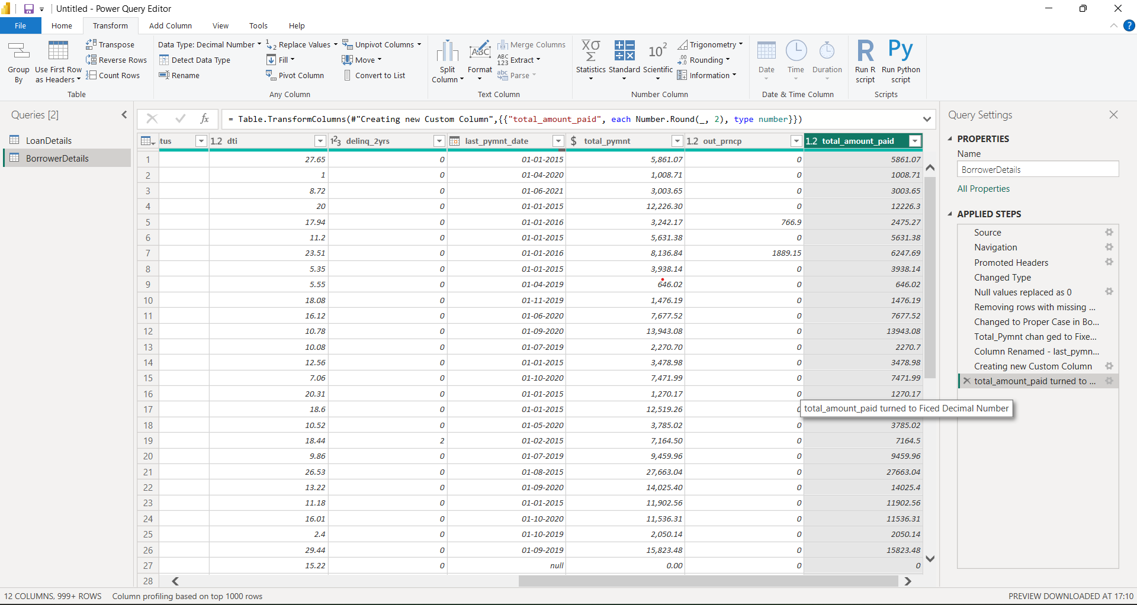
Creating New Columns
Create a new custom column named 'total_amount_paid' to calculate the total amount paid by each borrower by subtracting 'out_prncp' from 'total_pymnt'.
FORMUILA : ‘Total_Amount_Paid’ = [Total_Pymnt] – [Out_Prncp]

Slide 15
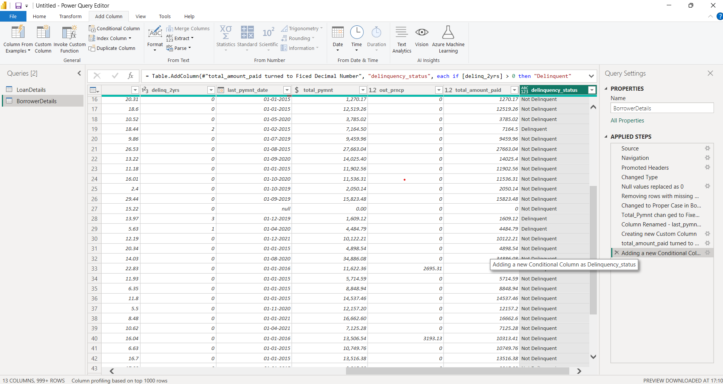
Add a new conditional column named 'delinquency_status' to identify if the borrower has any delinquencies. If the number of delinquencies in 'delinq_2yrs’ is greater than 0, the status should be "Delinquent", otherwise "Not Delinquent".
FORMULA : ‘Delinquency_Status’ = If([Deling_2yrs] > 0 Then’Delinquent’ else ‘Not Delinquent’)

Slide 16
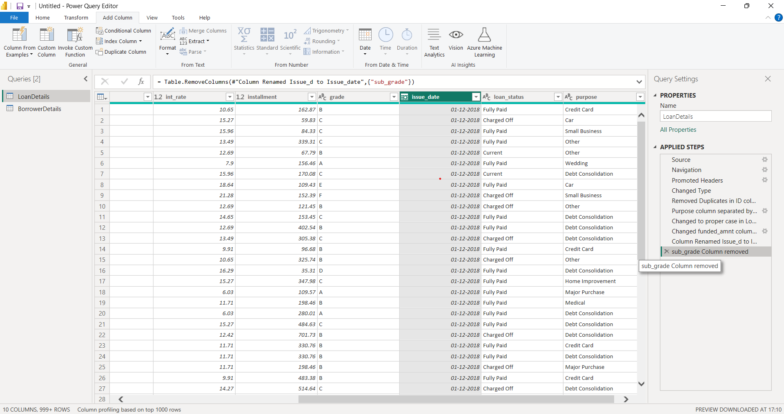
Column Dropping
Remove the 'sub_grade' column as that does not significantly contribute to the analysis.

Slide 17
3. DATA MODELING

Slide 18
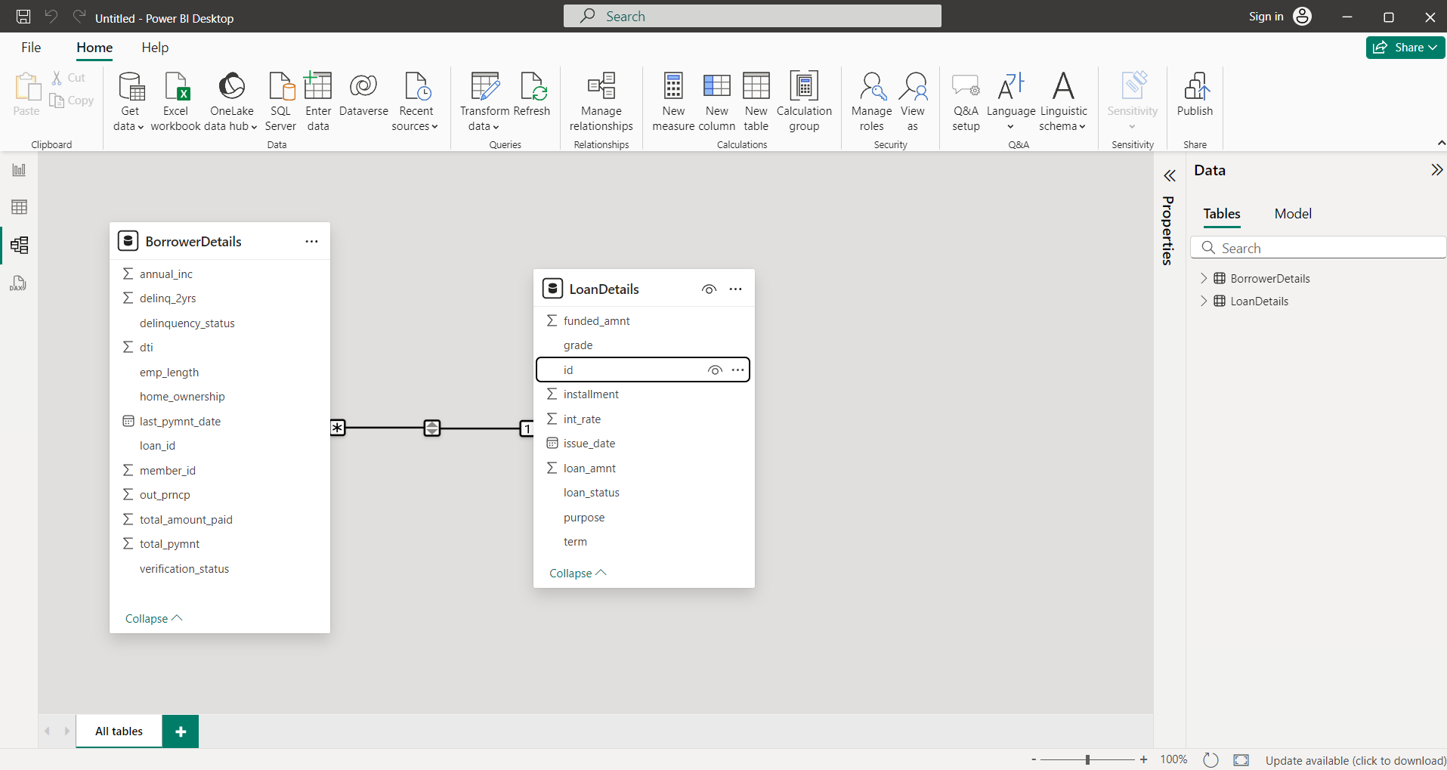
Identify the common column between both the tables and establish relationships between the two tables. Ensure the cross-filter direction is set to "Both". This step is crucial for enabling cross-table analysis and ensuring data integrity within the dataset.

Slide 19
4. Creating Measures and Calculated Columns using DAX

Slide 20
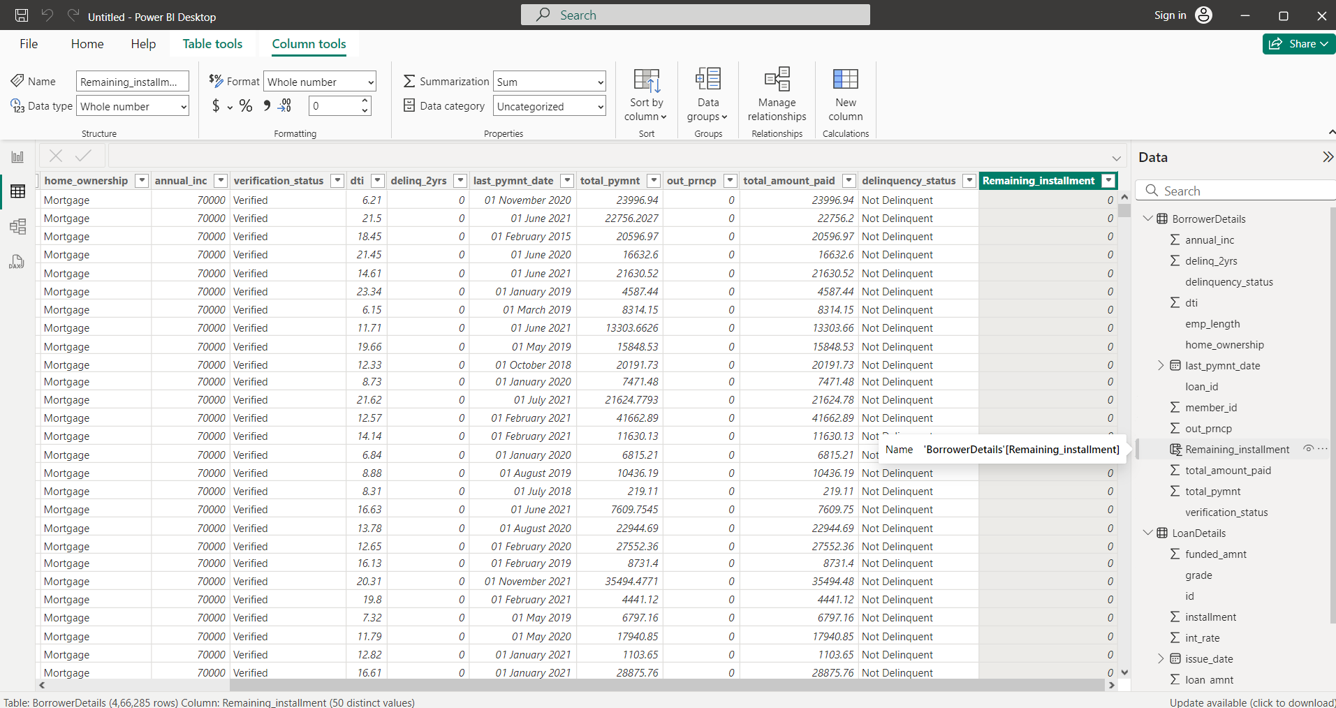
Create a new calculated column named 'remaining_installments' using DAX in the "BorrowerDetails" table to calculate the number of remaining installments by dividing the remaining principal amount ('out_prncp') by the monthly installment amount ('installment') and round up the result using the CEILING() function to account for any partial payments.
FORMULA : Remaining_Installments = CEILING((Borrower Details [Out_Prncp] / RELATED (Loan Details
[Installment])),1)

Slide 21
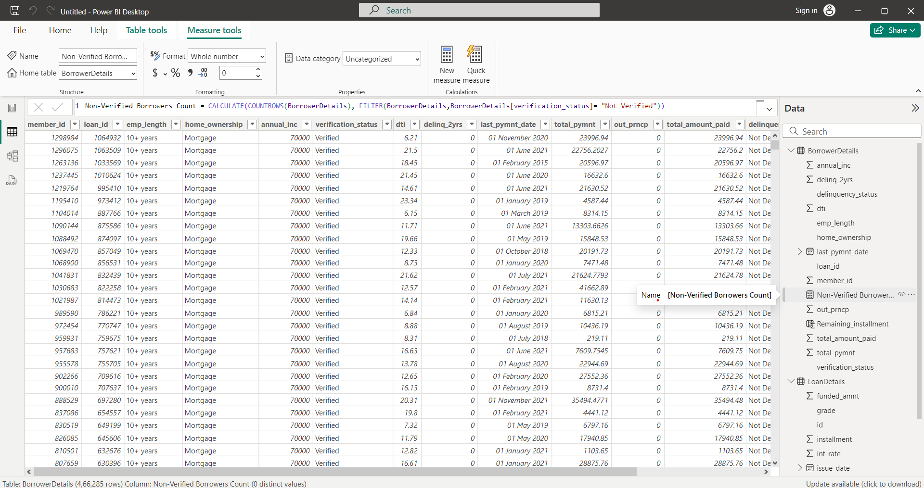
Create a measure named 'Non-Verified Borrowers Count' using DAX to count the number of loans that have been 'Not Verified'.
FORMULA : Non – Verified Borrower Count = CALCULATE (COUNT ROWS (Borrower Details) , FILTER
(Borrower Details, Borrower Details [ Verification_Status] = ‘Not Verified”))

Slide 22
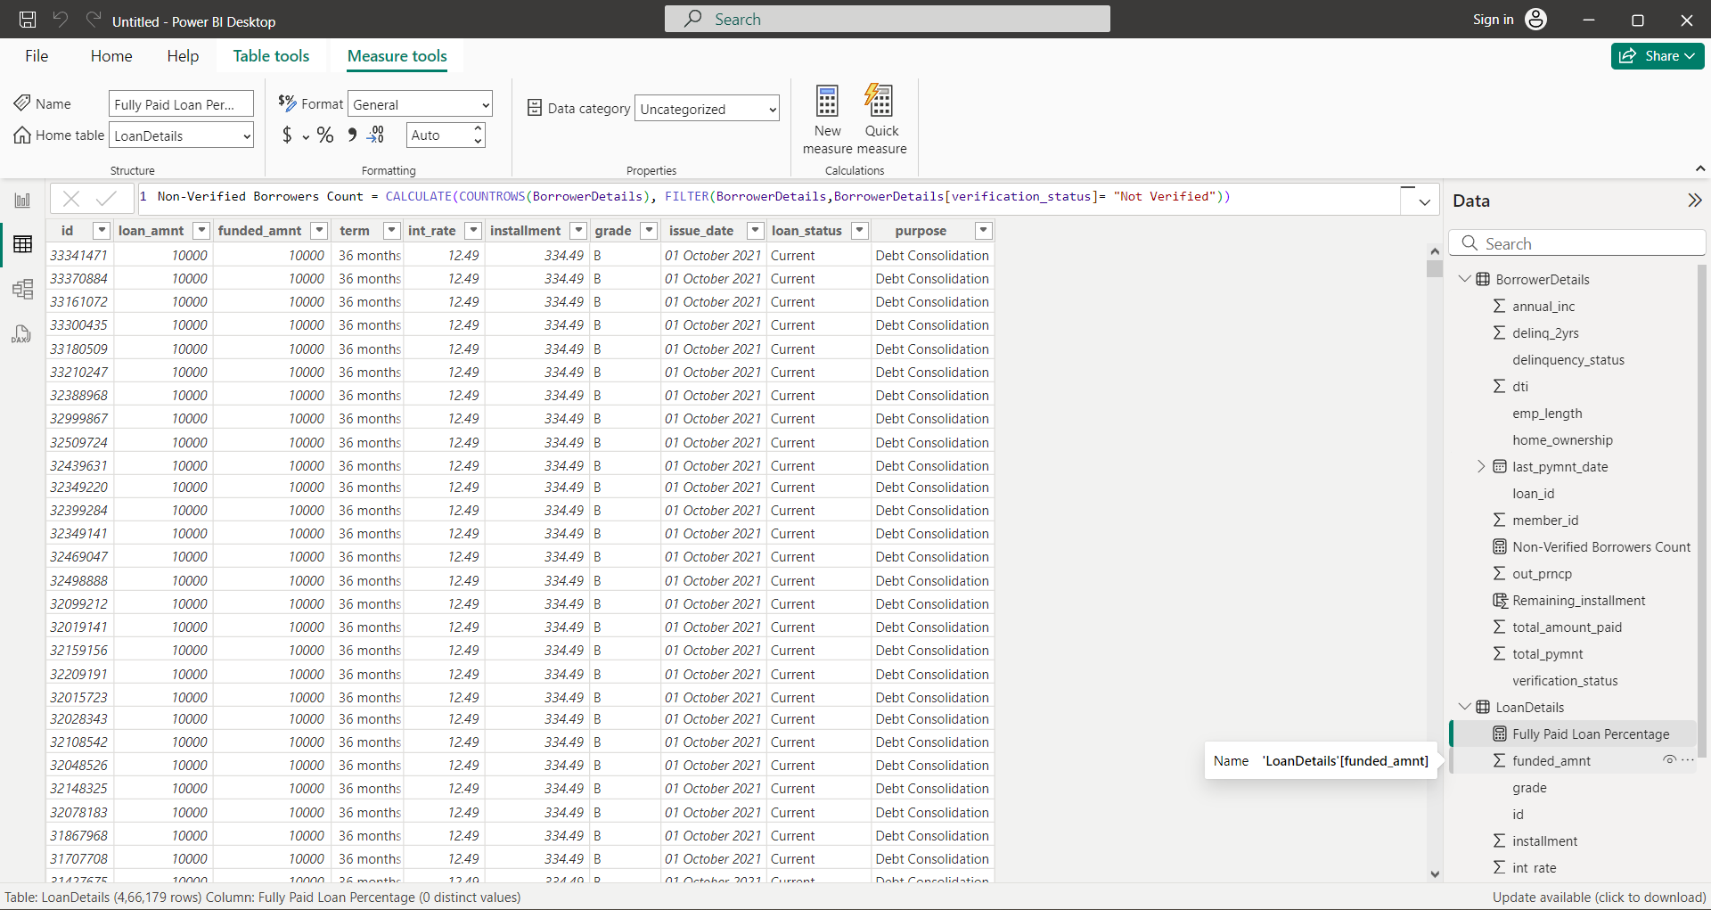
Create a measure named 'Fully Paid Loan Percentage' to calculate the percentage of fully paid loans. Divide the number of loans with a "Fully Paid" loan status by the total number of loans and then format this measure as Percentage.
FORMULA : Fully Paid Loan Percentage = DIVIDE (COUNT ROWS (FILTER (Loan Details, Loan Details
[Loan_Status] = ‘Fully Paid’)), COUNT ROWS (Loan Details))

Slide 23
5. Creating Comprehensive Reports

Slide 24
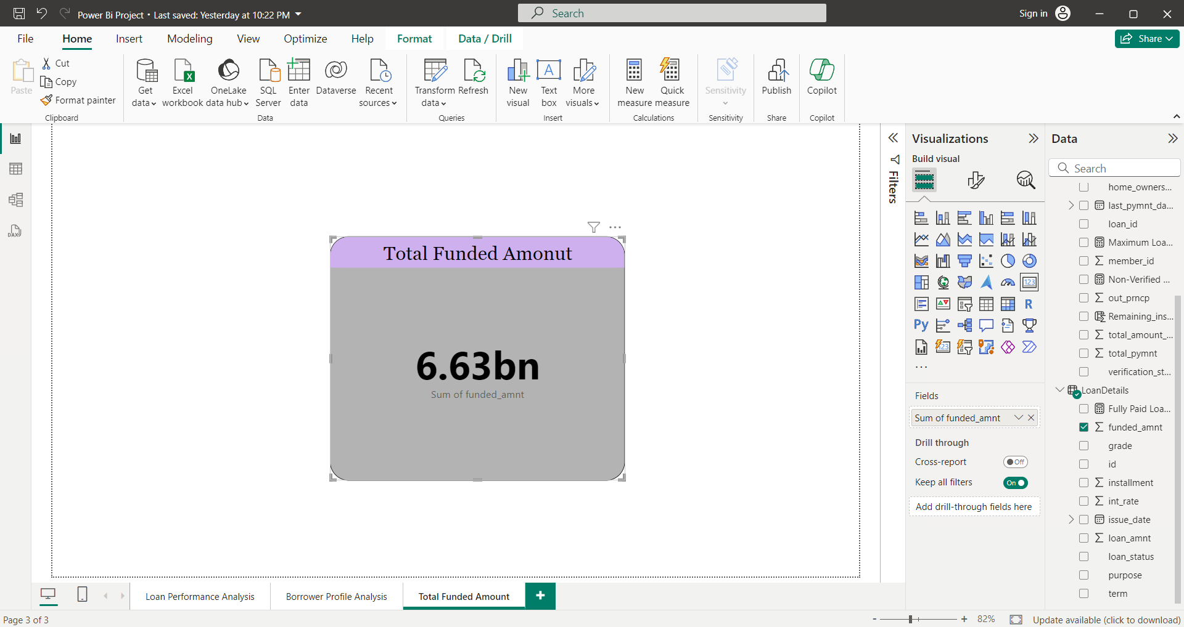
Report 1: Loan Performance Analysis
Total Funded Amount: Create a card visual to display the total funded amount.

Slide 25
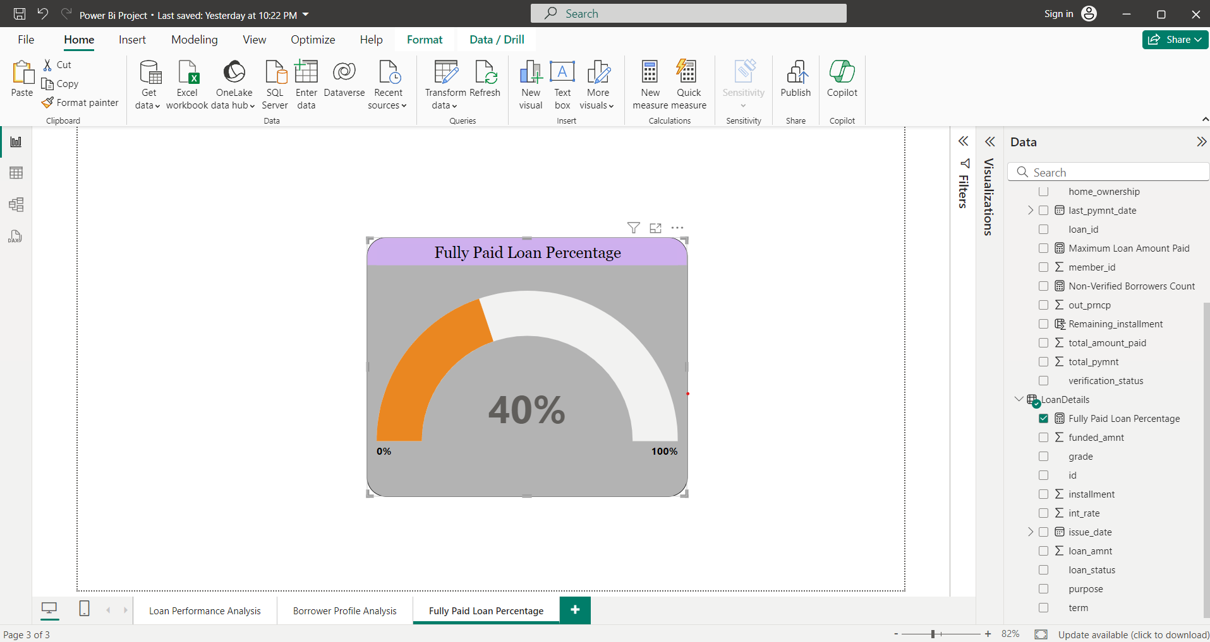
Fully Paid Loan Percentage: Create a gauge chart to display the 'Fully Paid Loan Percentage’
measure.

Slide 26
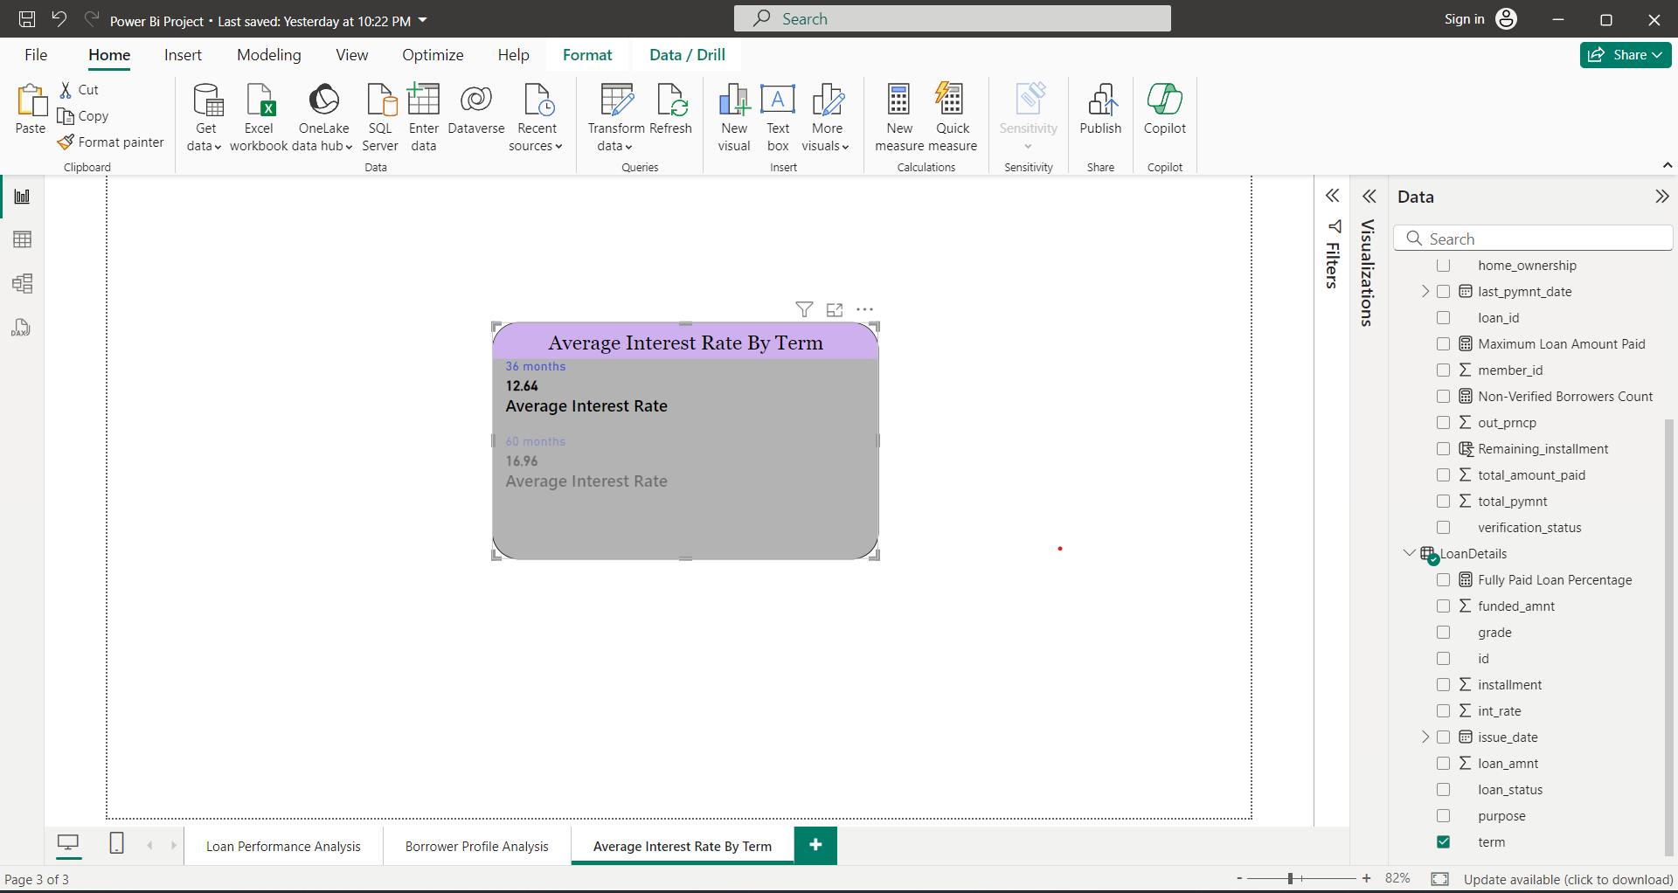
Average Interest Rate by Term: Create a multi-row card to show the average interest rate for each
term.

Slide 27
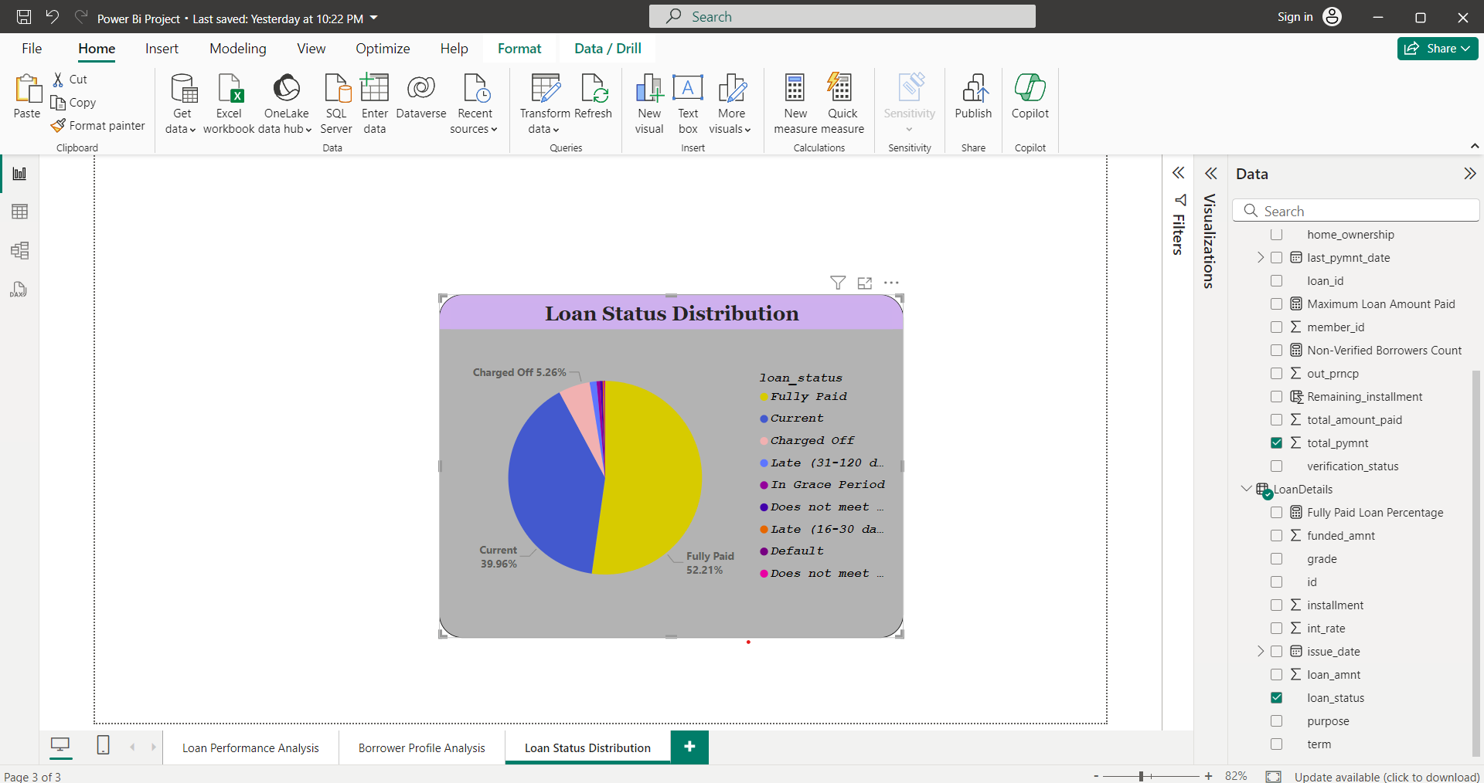
Loan Status Distribution: Create a pie chart to visualize the sum of total payments by loan status.

Slide 28
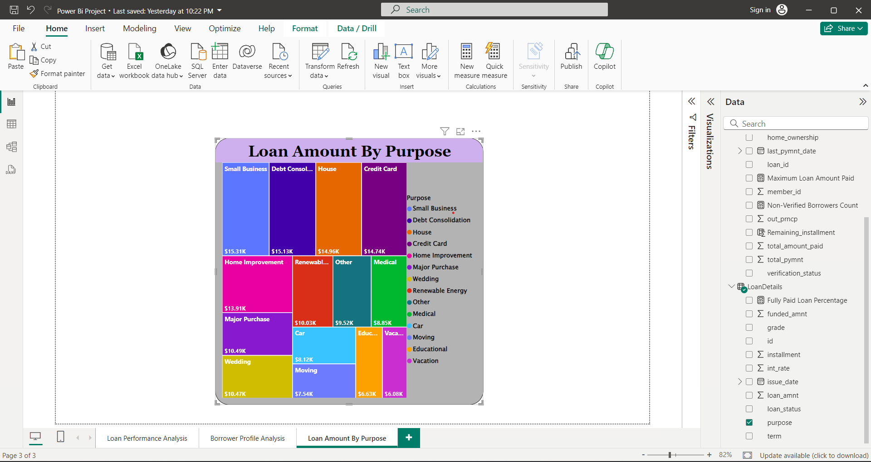
Loan Amount by Purpose: Create a treemap to show the average loan amount by purpose.

Slide 29
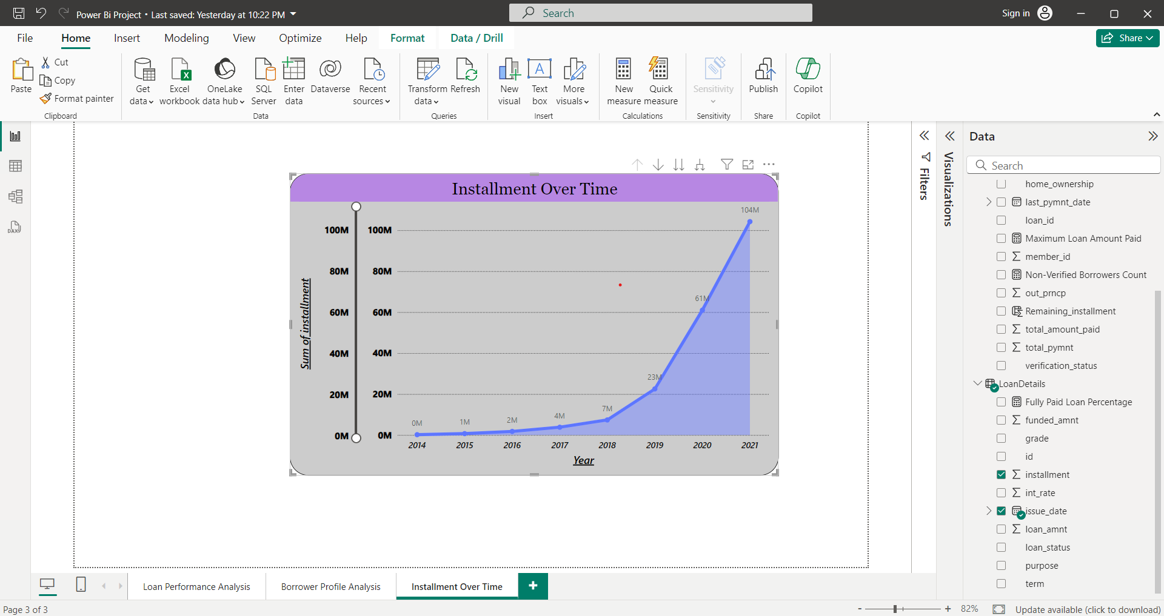
Installment Over Time: Create a line chart to visualize the sum of installments by Year and Quarter of
the issue date.

Slide 30
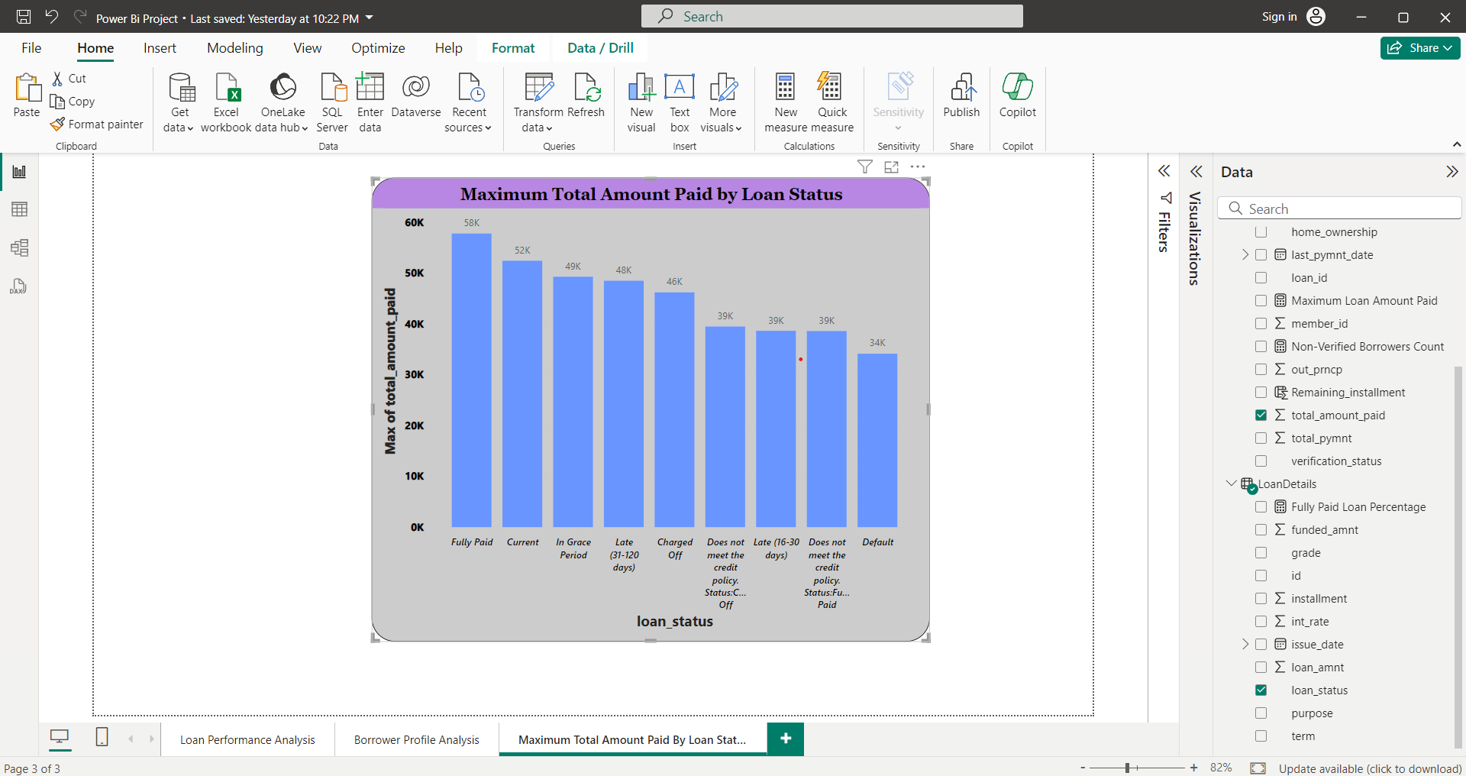
Maximum Total Amount Paid by Loan Status: Create a column chart to display the maximum total
amount paid by loan status.

Slide 31
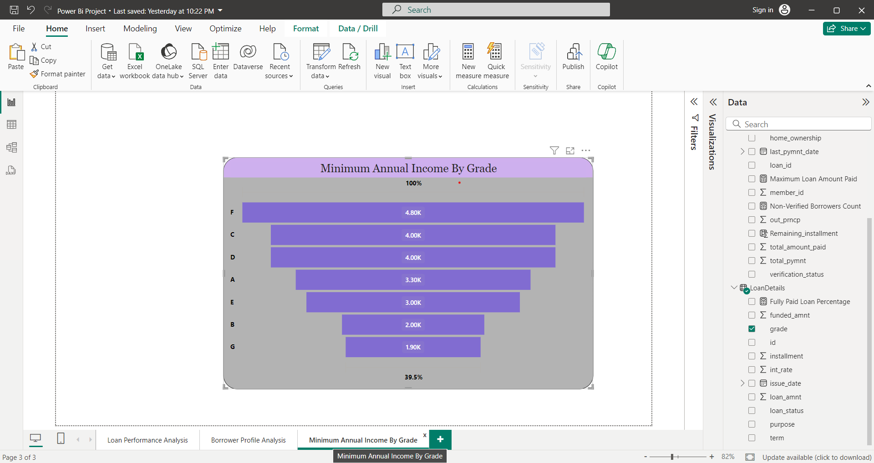
Minimum Annual Income by Grade: Create a funnel chart to show the minimum annual income by grade.

Slide 32
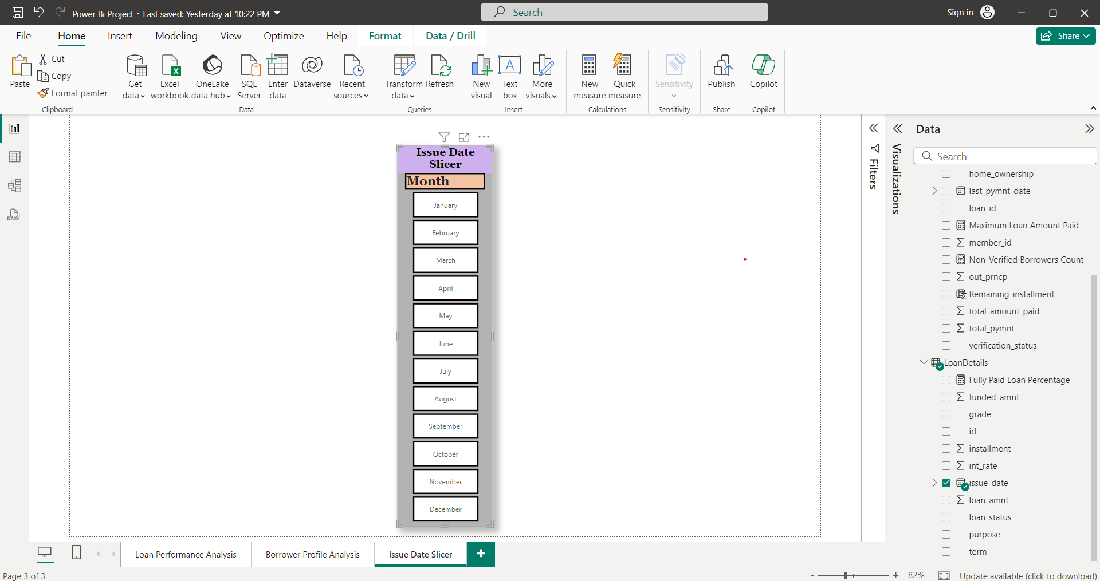
Issue Date Slicer: Add a slicer for the Month of the issue date to enable dynamic data exploration.

Slide 33
DashBoard of Loan Performance analysis

Slide 34
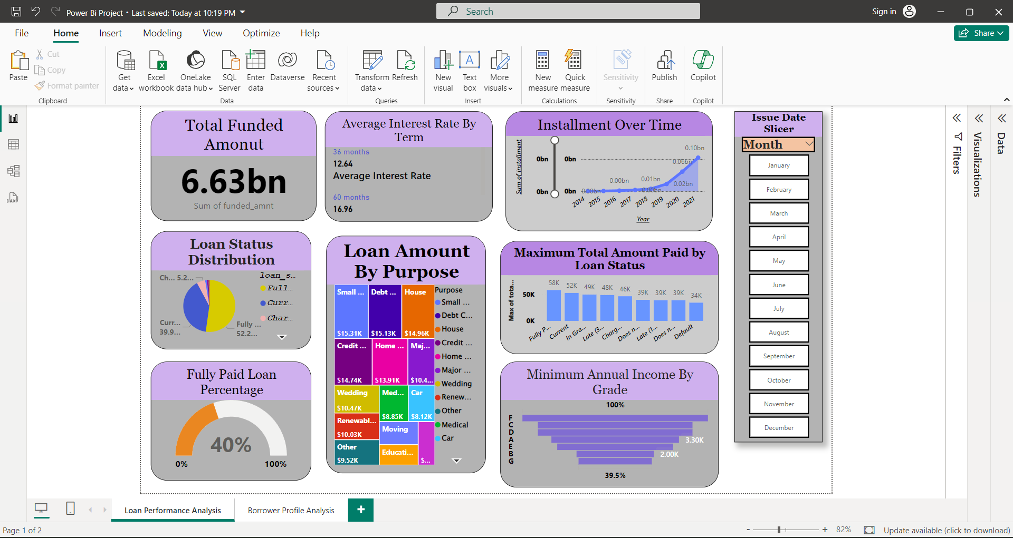

Slide 35
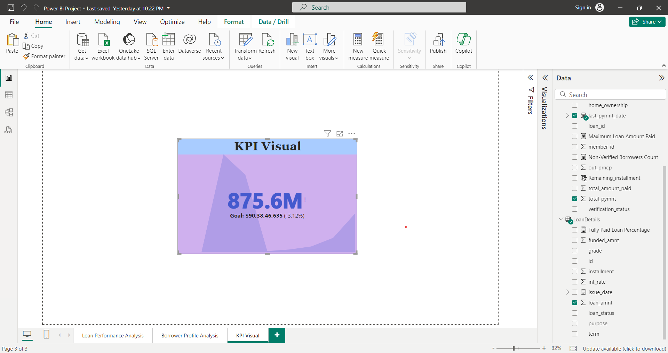
Report 2: Borrower Profile Analysis
KPI Visual: Create a KPI visual with the sum of total payment as the value, the year of last payment date as the trend axis, and the sum of loan amount as the target. Round off to 2 decimal points and format as $ currency.

Slide 36
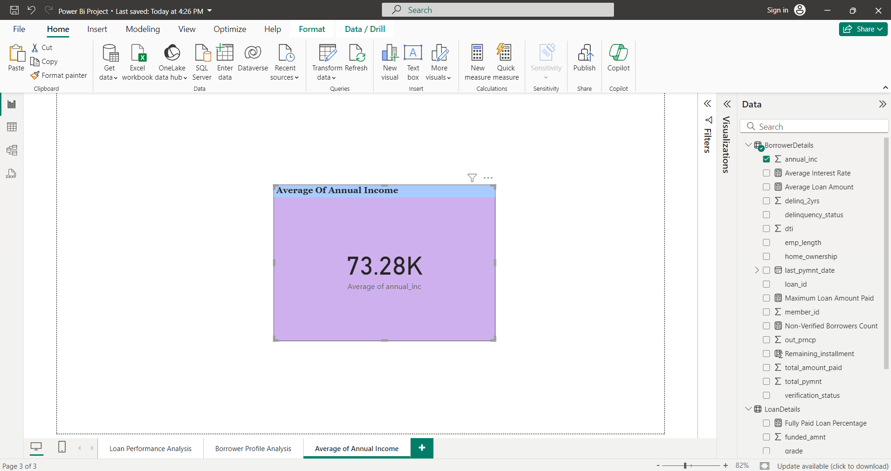
Average of Annual Income: Display the average of annual income using a card visual.

Slide 37
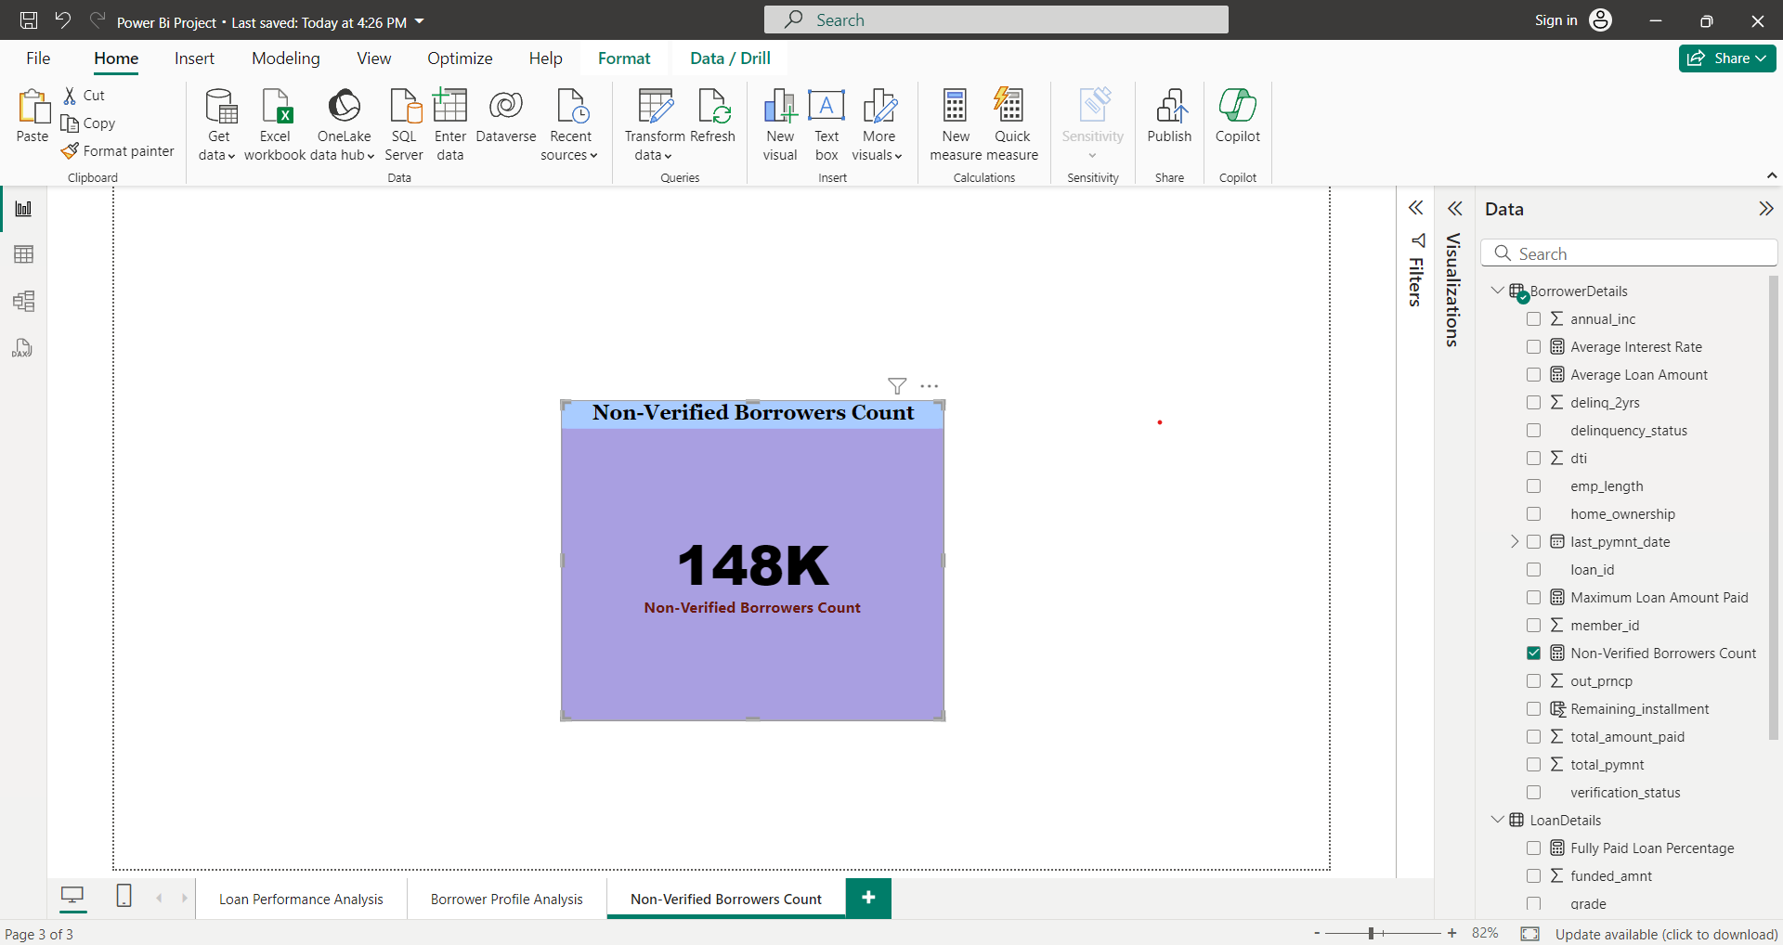
Non-Verified Borrowers Count: Display the count of non-verified borrowers using a card visual.

Slide 38
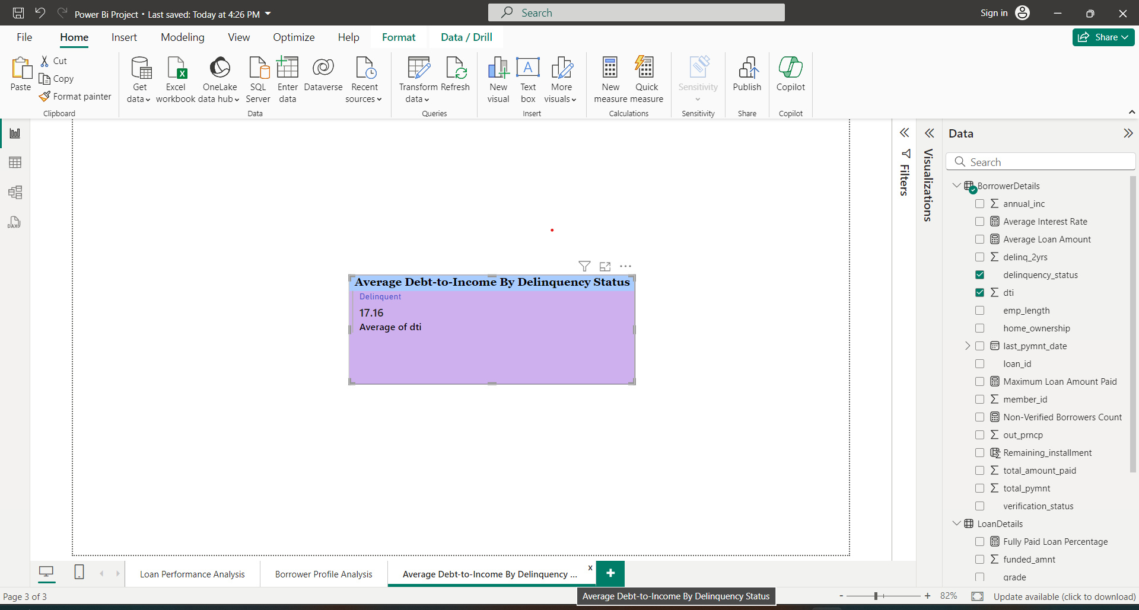
Average Debt-to-Income by Delinquency Status: Create a multi-row card to show the average debt-to-
income ratio by delinquency status.

Slide 39
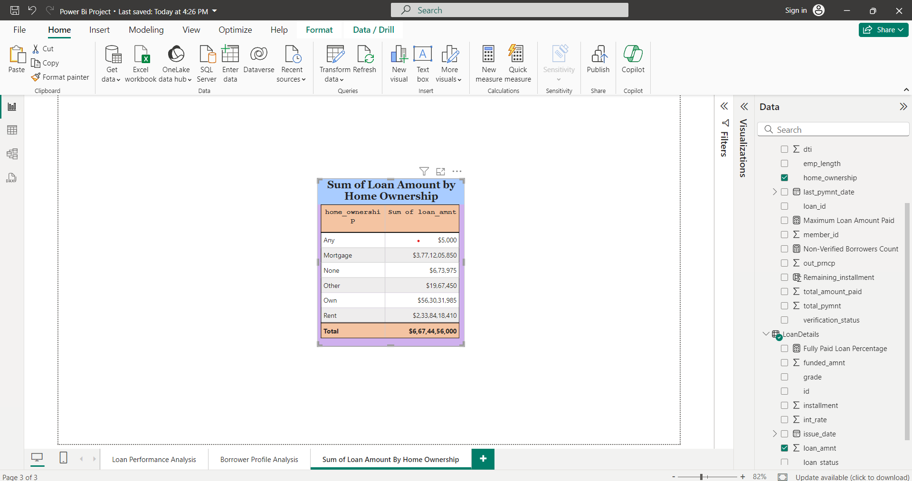
Sum of Loan Amount by Home Ownership: Create a table to show the total loan amount by home ownership.

Slide 40
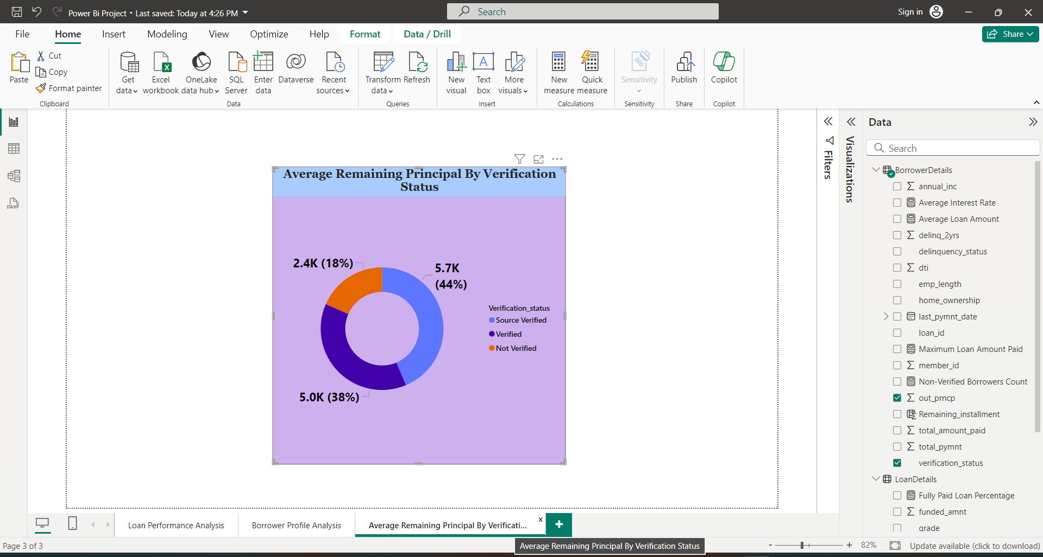
Average Remaining Principal by Verification Status: Create a donut chart to display the average remaining outstanding principal by verification status.

Slide 41
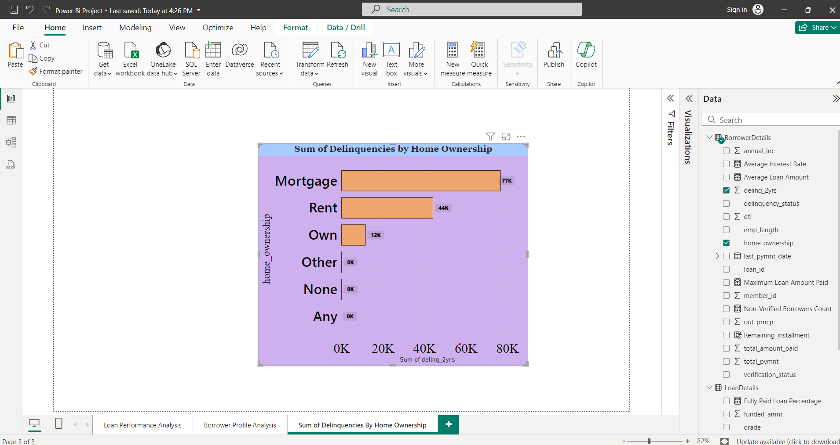
Sum of Delinquencies by Home Ownership: Create a bar chart to show the total number of delinquencies in the past 2 years by home ownership and filter the visual to display only Mortgage, Rent, and Own.

Slide 42
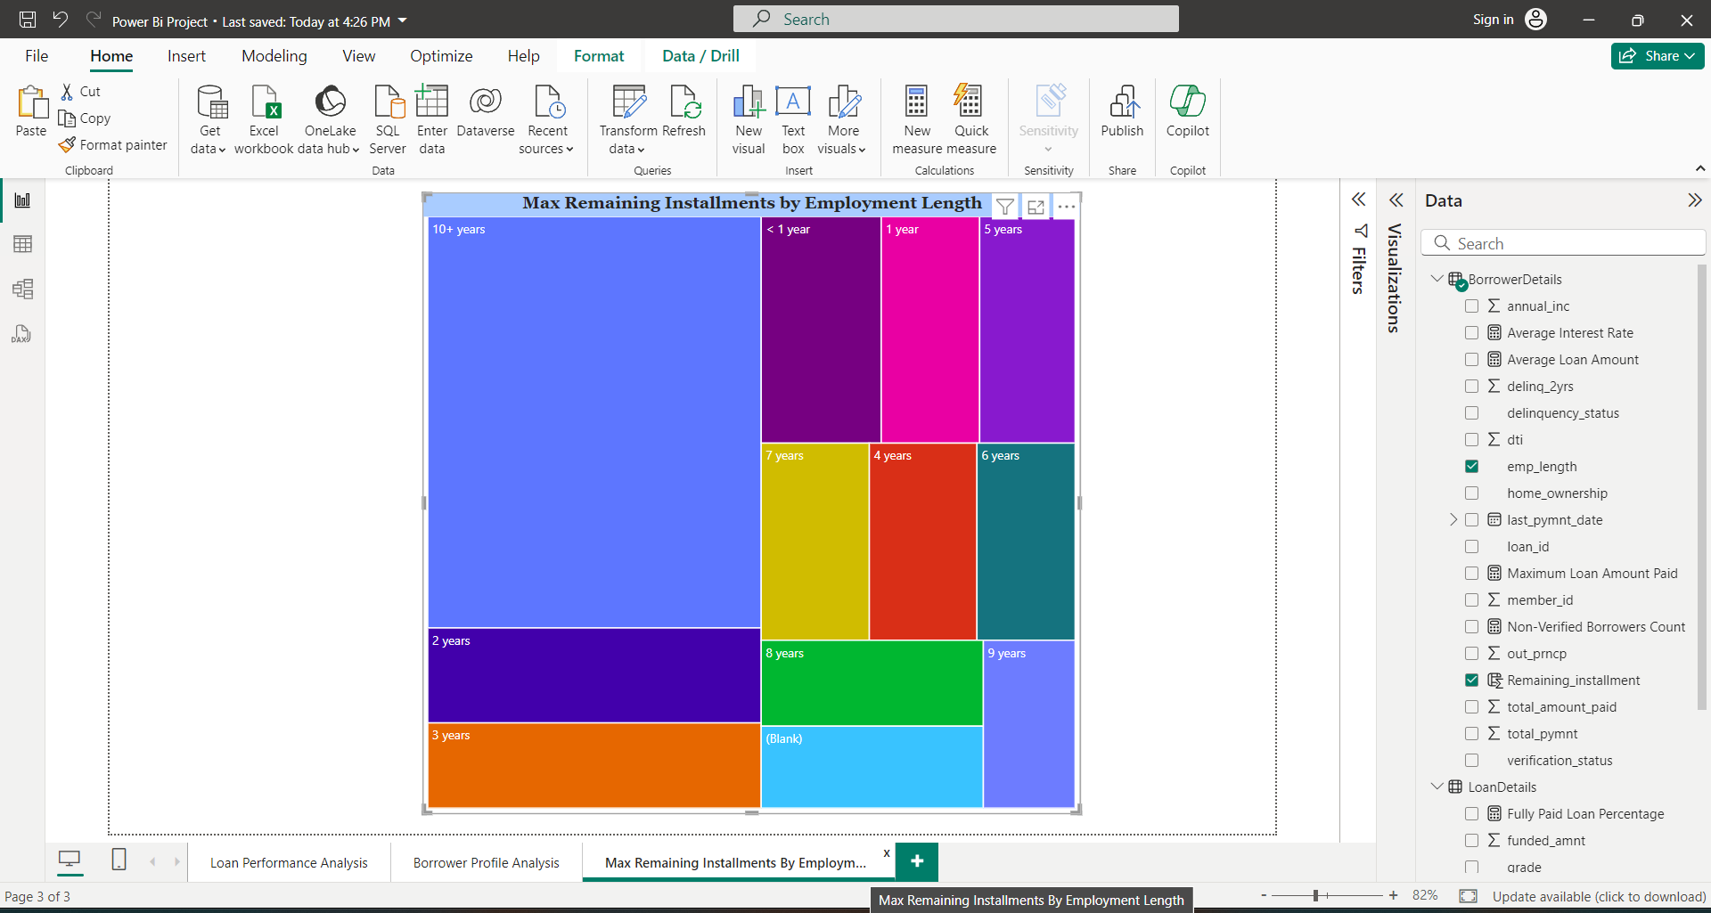
Max Remaining Installments by Employment Length: Create a treemap to show the maximum remaining installments by
employment length.

Slide 43
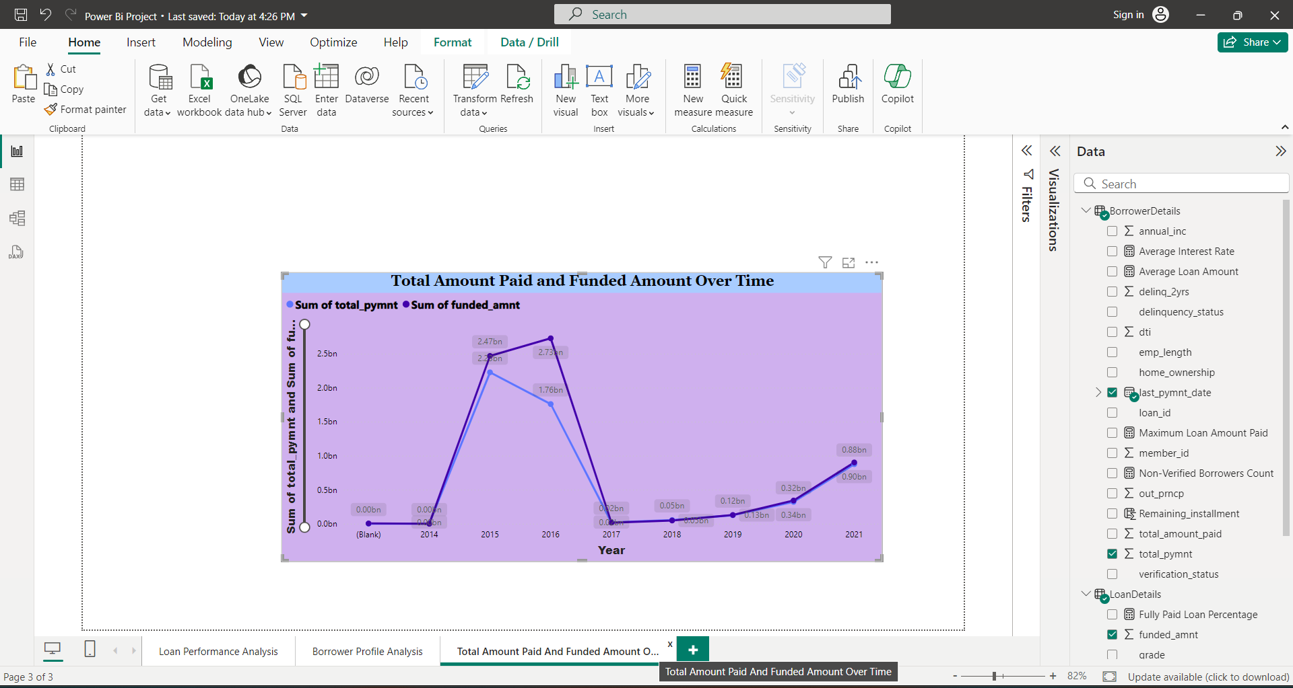
Total Amount Paid and Funded Amount Over Time: Create a line chart to display the sum of total amount paid and the sum of funded amount by the year of last payment date.

Slide 44
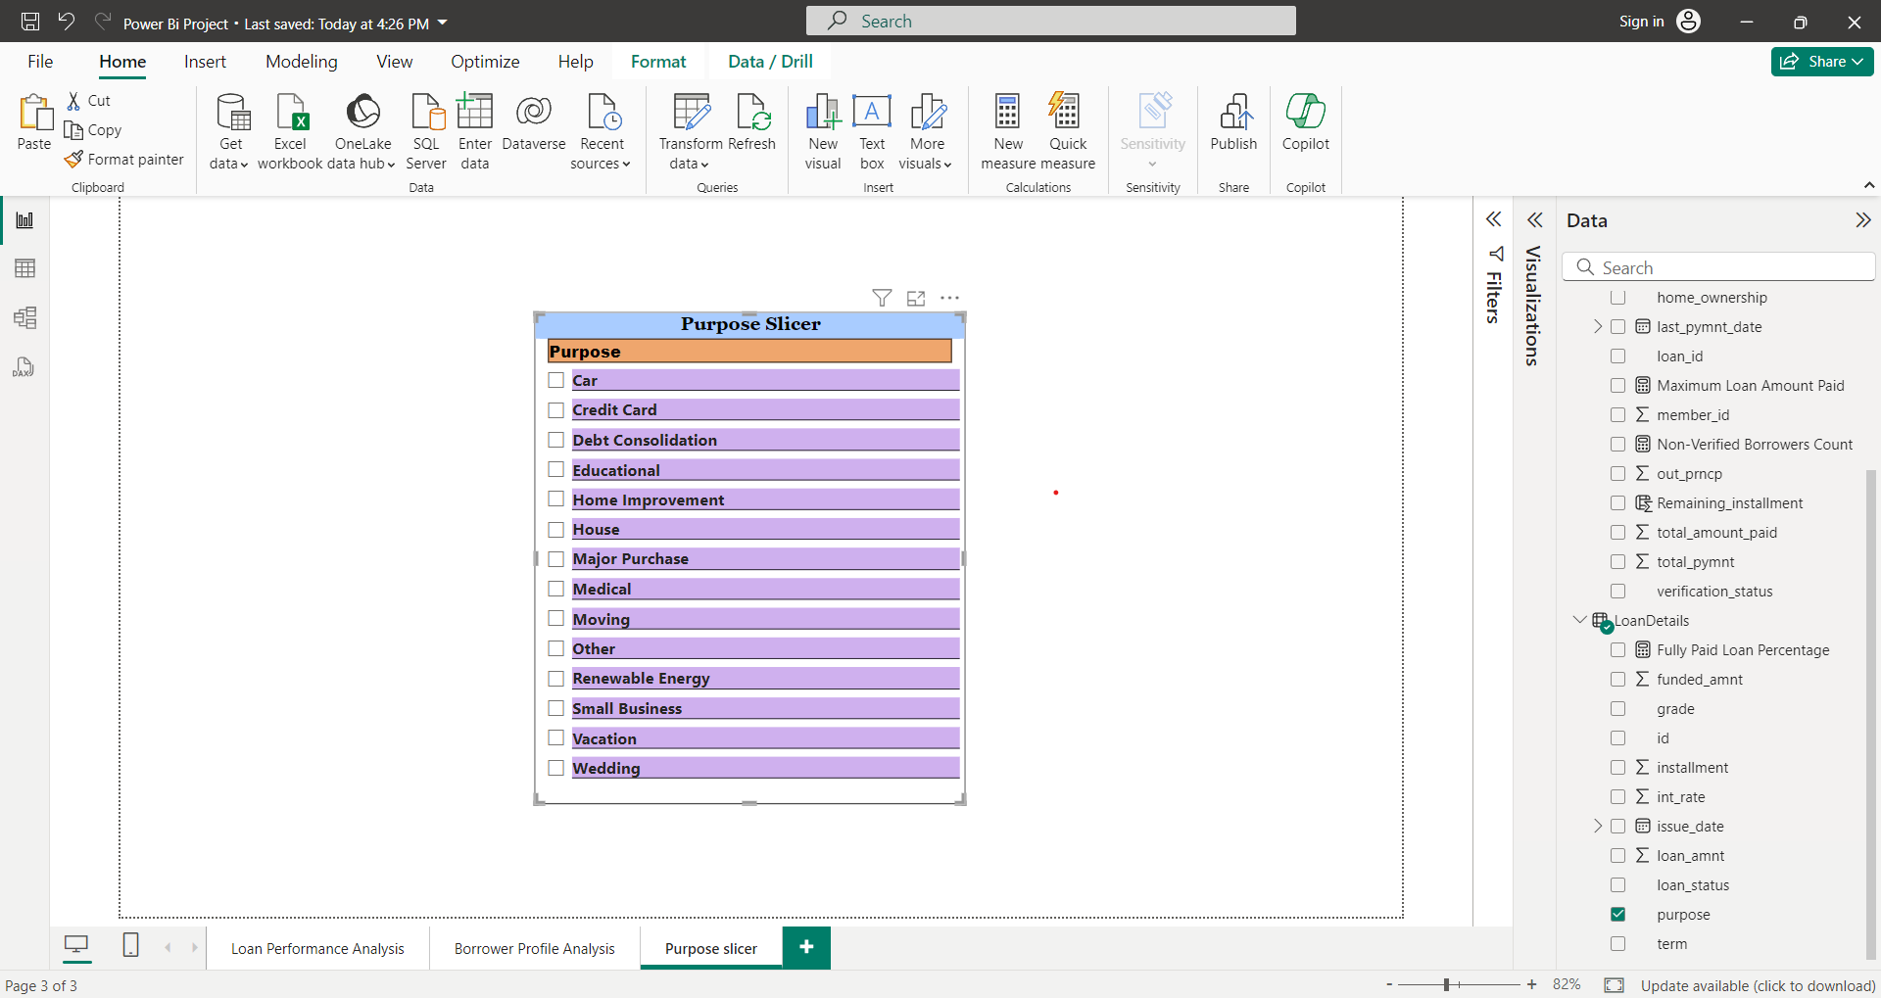
Purpose Slicer: Add a slicer for loan purpose to enable dynamic data exploration.

Slide 45
Dashboard of borrower profile analysis

Slide 46
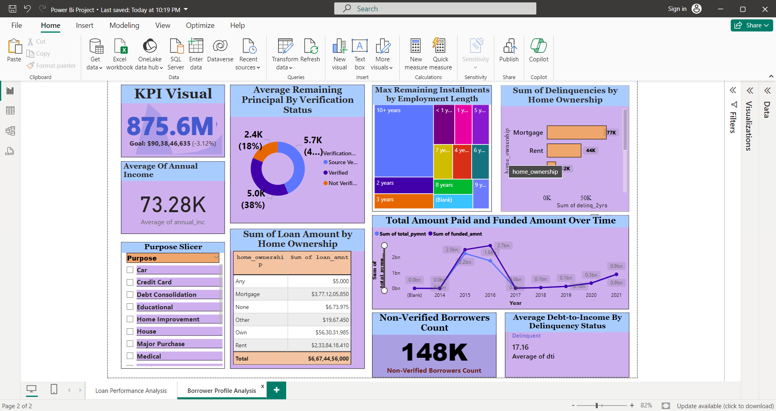

Slide 47
Thank you All

